Slide 1
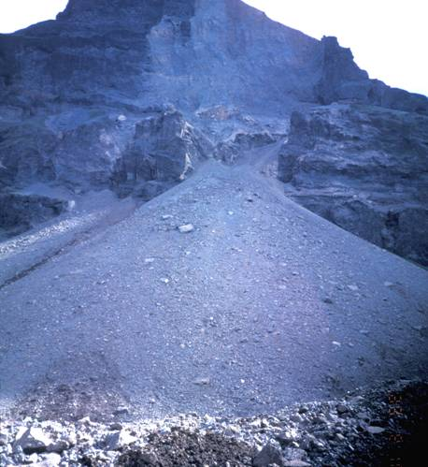
CHAPTER 6:
THRESHOLD OF MOTION AND SUSPENSION
Rock scree face in Iceland.

Slide 2
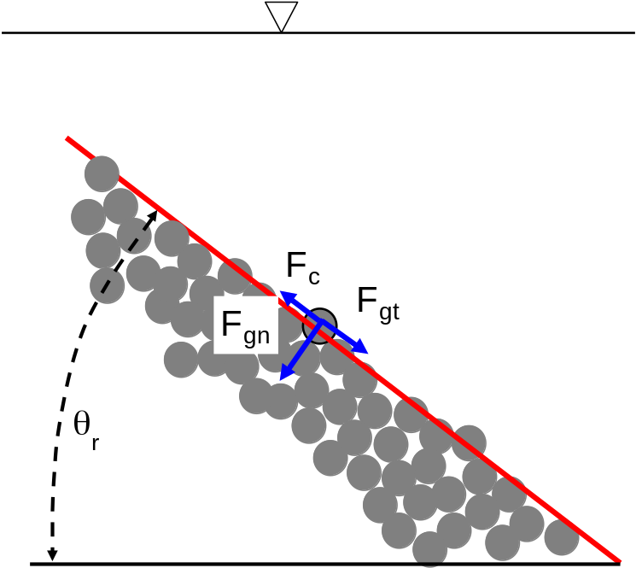
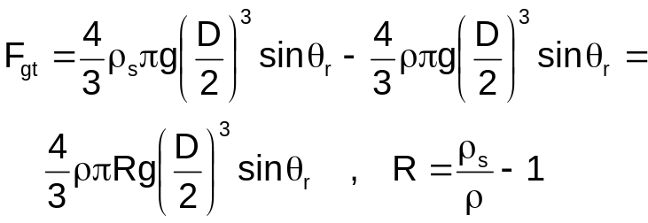
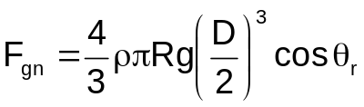
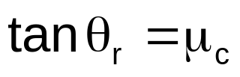
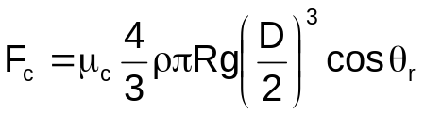

ANGLE OF REPOSE
A pile of sediment at resting at the angle of repose θ_{r} represents a threshold condition; any slight disturbance causes a failure. Here the pile of sediment is under water. Consider the indicated grain. The net downslope gravitational force acting on the grain (gravitational force – buoyancy force) is
The net normal force is
The net Coulomb resistive force to motion is
Force balance requires that
or thus:
which is how μ_{c} is measured (note that it is dimensionless). For natural sediments, θ_{r} ~ 30° ~ 40° and μ_{c} ~ 0.58 ~ 0.84.

Slide 3
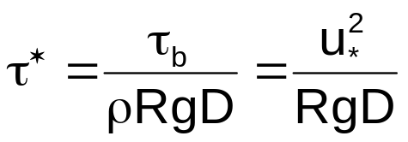

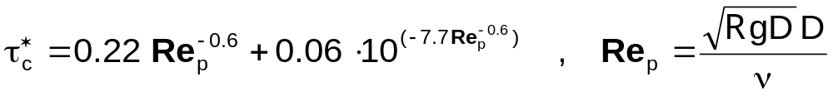
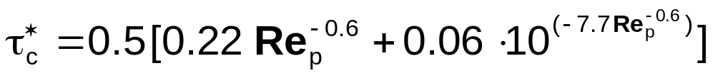
THRESHOLD OF MOTION
The Shields number τ* is defined as
Shields (1936) determined experimentally that a minimum, or critical Shields number is required to initiate motion of the grains of a bed composed of non-cohesive particles. Brownlie (1981) fitted a curve to the experimental line of Shields and obtained the following fit:
Based on information contained in Neill (1968), Parker et al. (2003) amended the above relation to
In the limit of sufficiently large Re_{p} (fully rough flow), then, becomes equal to 0.03.

Slide 4
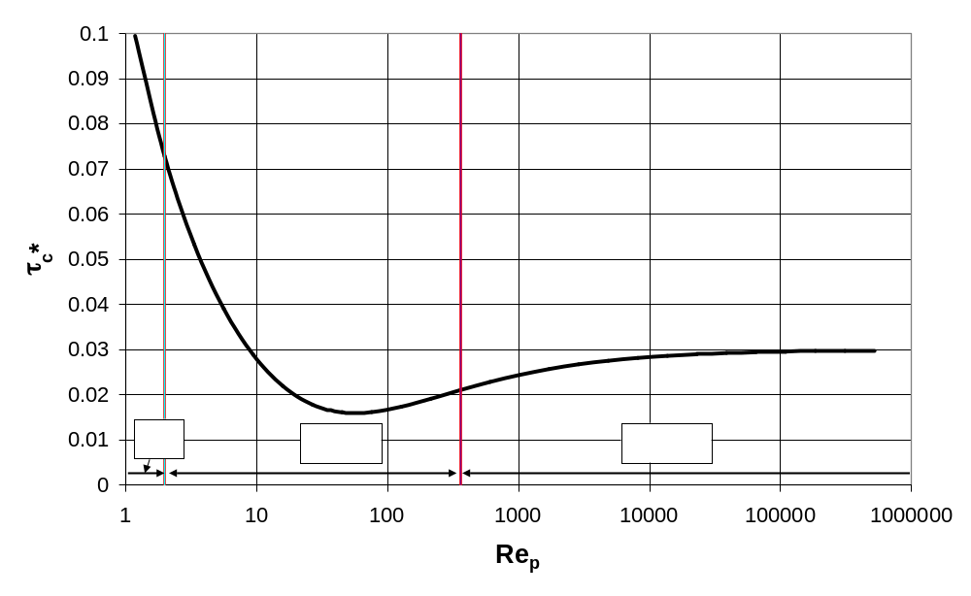
MODIFIED SHIELDS DIAGRAM
The silt-sand and sand-gravel borders correspond to the values of Re_{p} computed with R = 1.65, ν = 0.01 cm²/s and D = 0.0625 mm and 2 mm, respectively.

Slide 5
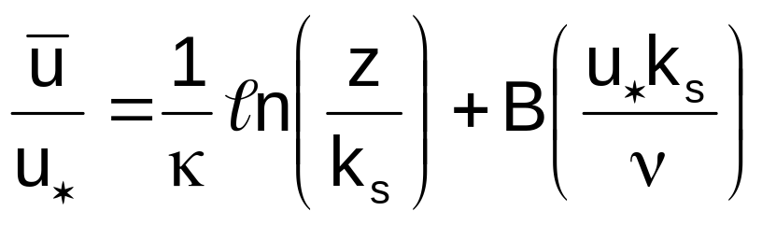
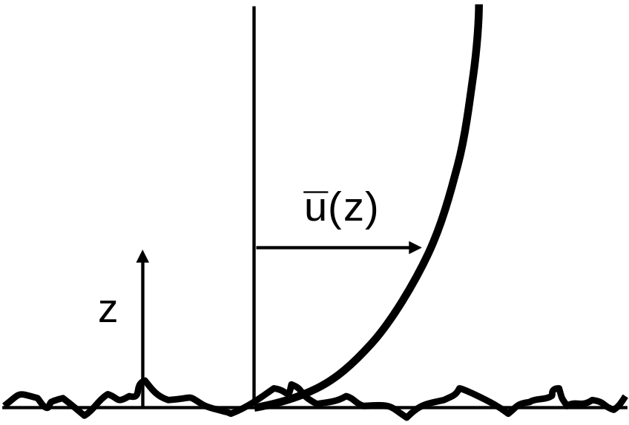

LAW OF THE WALL FOR TURBULENT FLOWS
Turbulent flow near a wall (such as the bed of a river) can often be approximated in terms of a logarithmic “law of the wall” of the following form:
where denotes streamwise flow velocity averaged over turbulence, z is a coordinate upward normal from the bed, u* = (τ_{b}/ρ)^{1/2} denotes the shear velocity, κ = 0.4 denotes the Karman constant and B is a function of the roughness Reynolds number (u*k_{s})/ν taking the form of the plot on the next page (e.g. Schlichting, 1968).

Slide 6
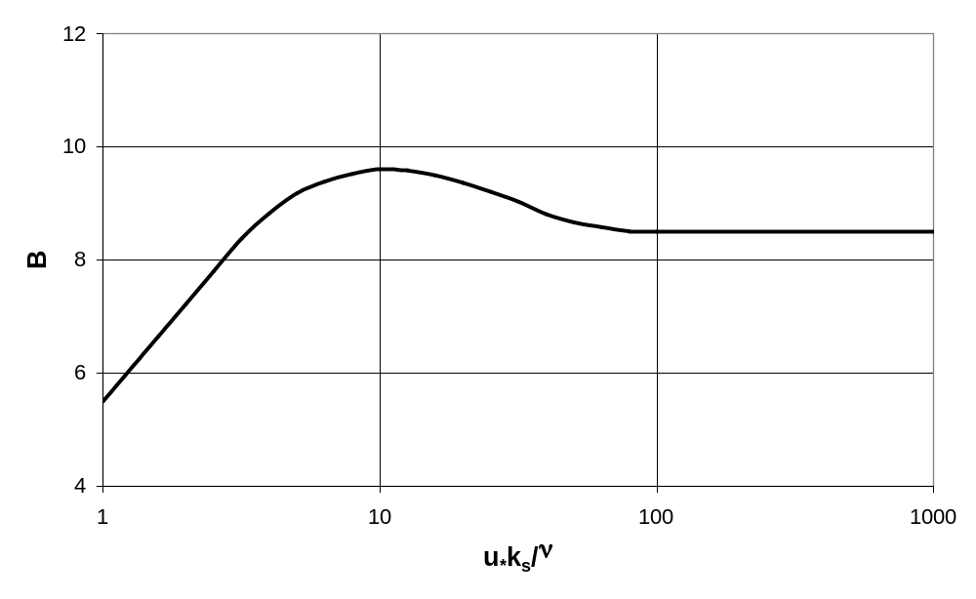
B AS A FUNCTION OF ROUGHNESS REYNOLDS NUMBER

Slide 7
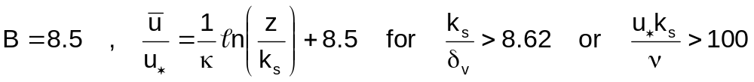
ROUGH, SMOOTH AND TRANSITIONAL REGIMES
Logarithmic form of law of the wall:
Viscosity damps turbulence near a wall. A scale for the thickness of this “viscous sublayer” in which turbulence is damped is δ_{v} = 11.6 ν/u* (Schlichting, 1968). If k_{s}/δ_{v} >> 1 the viscous sublayer is interrupted by the bed roughness, roughness elements interact directly with the turbulence and the flow is in the hydraulically rough regime:
If k_{s}/δ_{v} << 1 the viscous sublayer lubricates the roughness elements so they do not interact with turbulence, and the flow is in the “hydraulically smooth” regime:
For 0.26 < k_{s}/δ_{v} < 8.62 the near-wall flow is transitional between the
hydraulically smooth and hydraulically rough regimes.

Slide 8
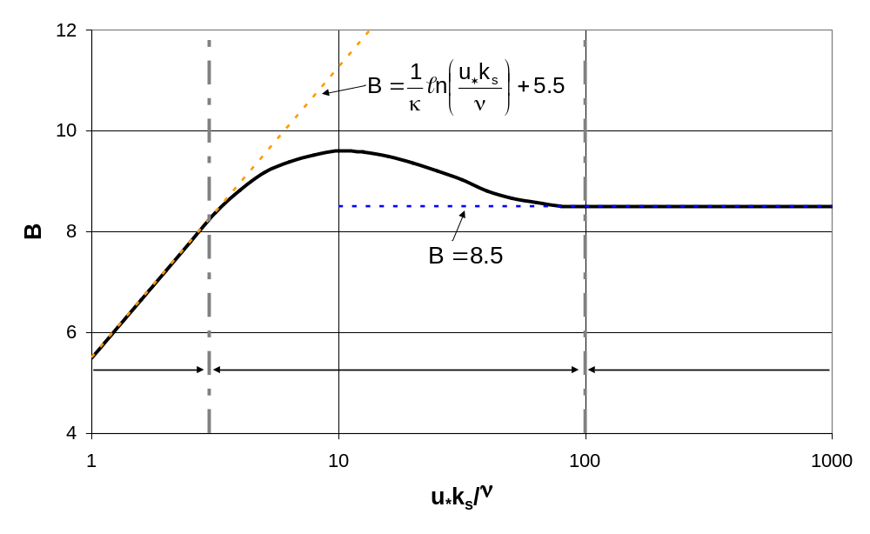
B AS A FUNCTION OF ROUGHNESS REYNOLDS NUMBER: REGIMES

Slide 9
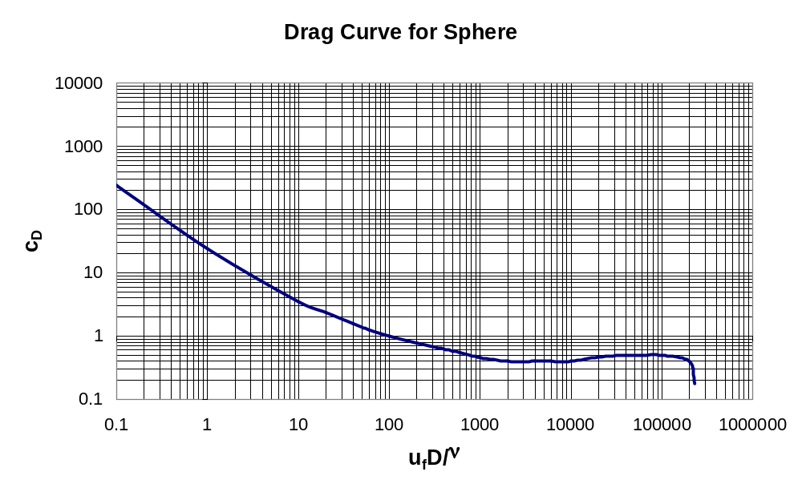
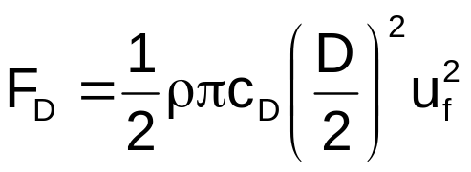
DRAG ON A SPHERE
Consider a sphere with diameter D immersed in a Newtonian fluid with density ρ and kinematic viscosity ν (e.g. water) and subject to a steady flow with velocity u_{f} relative to the sphere. The drag force on the sphere is given as
where the drag coefficient c_{D} is a function of the Reynolds number (u_{f}D)/ν, as given in the diagram to the right.
Note the existence of an “inertial range” (1000 < u_{f}D/ν < 100000) where c_{D} is between 0.4 and 0.5.

Slide 10
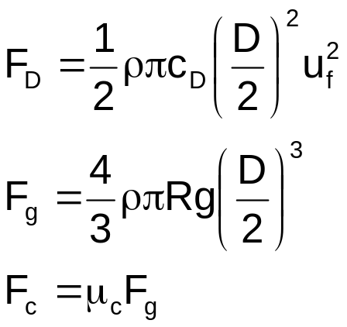
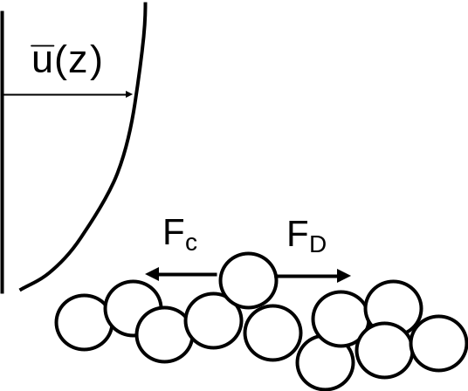
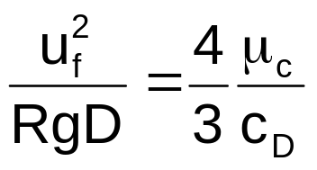

THRESHOLD OF MOTION: TURBULENT ROUGH FLOW, NEARLY FLAT BED
This is a brief and partial sketch: more detailed analyses can be found in Ikeda (1982) and Wiberg and Smith (1987). The flow is over a granular bed with sediment size D. The mean bed slope S is small, i.e. S << 1. Assume that k_{s} = n_{k}D, where n_{k} is a dimensionless, o(1) number (e.g. 2). Consider an “exposed” particle the centroid of which protrudes up from the mean bed by an amount n_{e}D, where n_{e} is again dimensionless and o(1). The flow over the bed is assumed to be turbulent rough, and the drag on the grain is assumed to be in the inertial range. Fluid drag tends to move the particle; Coulomb resistance impedes motion.
Impelling fluid drag force
Submerged weight of grain
Coulomb resistive force
Threshold of motion:
or thus

Slide 11
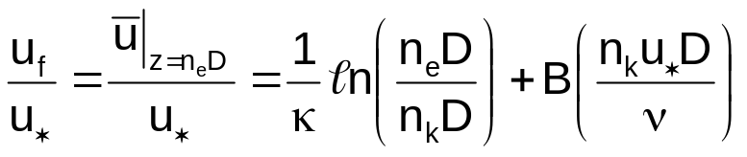
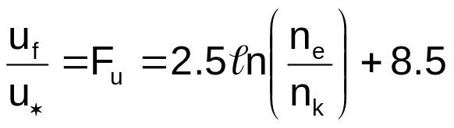
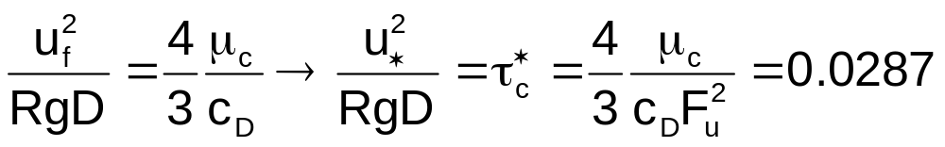
THRESHOLD OF MOTION: TURBULENT ROUGH FLOW, NEARLY FLAT BED (contd.)
Since k_{s} = n_{k}D and the centroid of the particle is at z = n_{e}D, the mean flow velocity acting on the particle u_{f} is given from the law of the wall as
As long as n_{k}u*D/ν > 100, B can be set equal to 8.5, so that
In addition, if u_{f}D/ν = F_{u}u*D/ν is between 1000 and 100000, c_{D} can be approximated as 0.45. Setting n_{k} = n_{e} = 2 as an example, it is found that F_{u} = 8.5. Further assuming that μ_{c} = 0.7, the Shields condition for the threshold of motion becomes
This is not a bad approximation of the asymptotic value of τ_{c}* from the modified Shields curve of 0.03 for (RgD)^{1/2}D/ν→∞. For a theoretical derivation of the full Shields curve see Wiberg and Smith (1987).

Slide 12


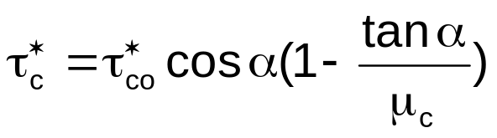
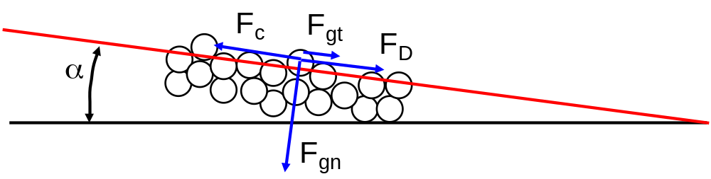
CASE OF SIGNIFICANT STREAMWISE SLOPE
Let α denote the angle of streamwise tilt of the bed, so that
If α is sufficiently high then in addition to the drag force F_{D} , there is a direct tangential gravitational force F_{gt} impelling the particle downslope.
Force balance:
or reducing,
where τ_{c}* = the critical Shields number on the slope and τ_{co}* = the value on a nearly horizontal bed.

Slide 13
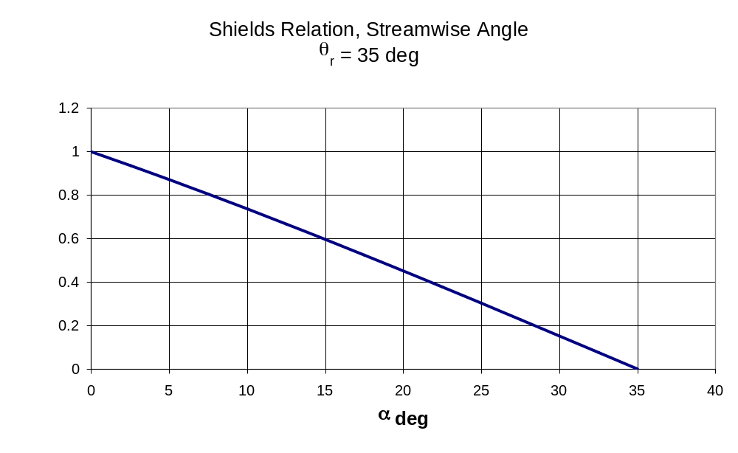
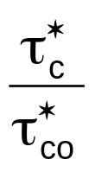
VARIATION OF CRITICAL SHIELDS STRESS WITH STREAMWISE BED SLOPE

Slide 14
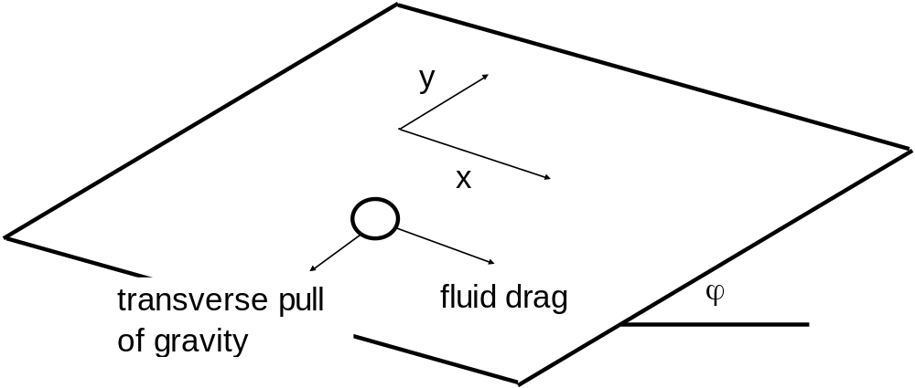
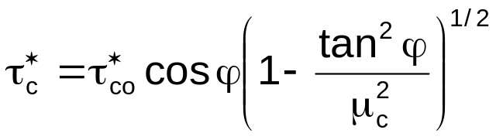
CASE OF SIGNIFICANT TRANSVERSE SLOPE (BUT NEGLIGIBLE STREAMWISE SLOPE)
Let ϕ denote the angle of transverse tilt of the bed
A formulation similar to that for streamwise tilt yields the result:
A general formulation of the threshold of motion for arbitrary bed slope is given in Seminara et al. (2002). This formulation includes a lift force acting on a
particle, which has been neglected for simplicity in the present analysis.

Slide 15
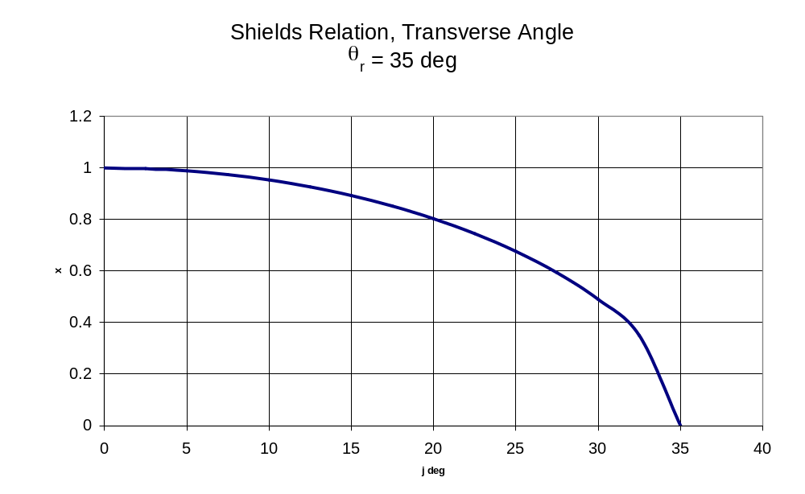

VARIATION OF CRITICAL SHIELDS STRESS WITH TRANSVERSE BED SLOPE

Slide 16


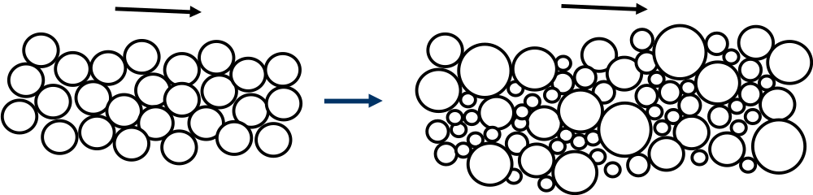
SEDIMENT MIXTURES: COARSER GRAINS ARE HARDER TO MOVE
In the limiting case of coarse gravel of uniform size D, the modified Brownlie relation of Slides 3 and 4 predicts a critical Shields number of 0.03, so that the boundary shear stress τ_{bc} at which the gravel moves is given by the relation
Now this uniform coarse gravel is replaced with a mixture of gravel sizes D_{i} such that the geometric mean size of the surface layer (i.e. the layer exposed to the flow) D_{sg} is identical to the size D of the uniform gravel. It is further assumed (for the sake of simplicity) that each gravel D_{i} in the mixture is coarse enough so that the critical Shields stress of uniform sediment with size D_{i} would also be 0.03.

Slide 17


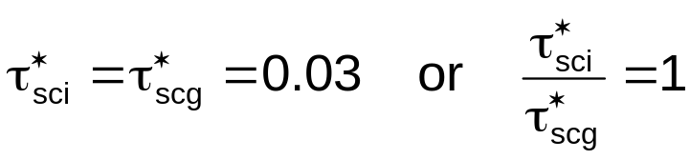
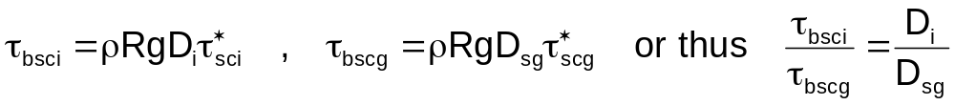
SEDIMENT MIXTURES: COARSER GRAINS ARE HARDER TO MOVE contd.
If every grain in the mixture acted as though it were surrounded by grains of the same size as itself, the critical Shields number for all sizes D_{i} in the surface layer exposed to the flow would be constant at 0.03, which would also be the critical Shields number for the surface geometric mean size D_{sg}. Thus the following relation would hold;
If this were true the critical shear stresses τ_{bsci} and τ_{bscg} for sizes D_{i} and D_{g}, respectively, in the surface layer would be given as

Slide 18
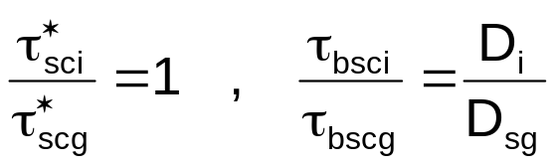
SEDIMENT MIXTURES: COARSER GRAINS ARE HARDER TO MOVE contd.
So if every grain in the mixture acted as though it were surrounded by grains of the same size as itself, the critical Shields number would be the same for all grains in the surface, and the boundary shear stress τ_{bsgi} required to move grain size D_{i} would increase linearly with size D_{i}. That is, if each grain acted as if it were not surrounded by grains of different sizes (grain independence), a grain that is twice the size of another grain would require twice the boundary shear stress to move.
The above grain-independent behavior is mediated by differing grain mass. That is, larger grains are harder to move because they have more mass.

Slide 19
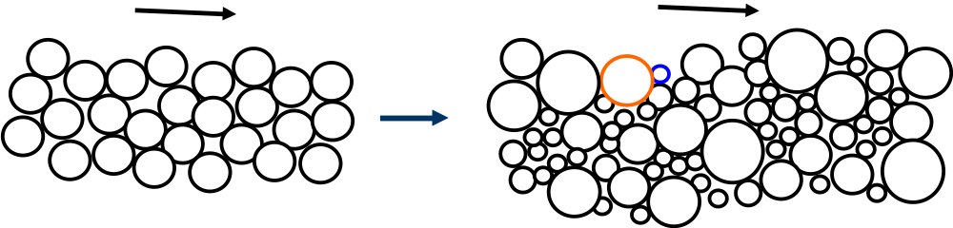
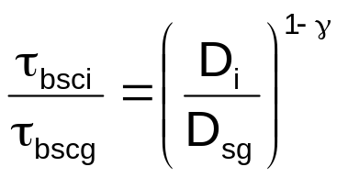
SEDIMENT MIXTURES: HIDING EFFECTS
Grains in a mixture do not act as though they are surrounded by grains of the same size. As Einstein (1950) first pointed out, on the average coarser grains exposed on the surface protrude more into the flow, and thus feel a preferentially larger drag force. Finer grains can hide behind and between coarse grains, so feeling a preferentially smaller drag force. These exposure effects are grouped together as hiding effects.
Hiding effects reduce the difference in boundary shear stress required to move different grain sizes in a mixture. As a result, the relation for τ_{bsci} is amended to
where in general 0 ≤ γ < 1.

Slide 20
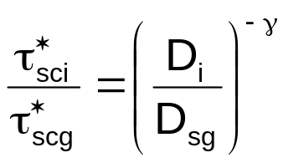
SEDIMENT MIXTURES: HIDING EFFECTS contd.
The relation
combined with the definitions
yield the result
The value γ = 0 yields the case of grain independence: there are no hiding effects, the critical Shields number is the same for all grain sizes, and the boundary shear stress required to move a grain in a mixture increases linearly with grain size. The value γ = 1 yields the equal threshold condition: hiding is so effective that it completely counterbalances mass effects, all grains in a mixture move at the same critical boundary shear stress, and critical Shields number increases as grain size D_{i} to the – 1 power.
In actual rivers the prevailing condition is somewhere between grain independence and the equal threshold condition, although it tends to be
somewhat biased toward the latter.

Slide 21
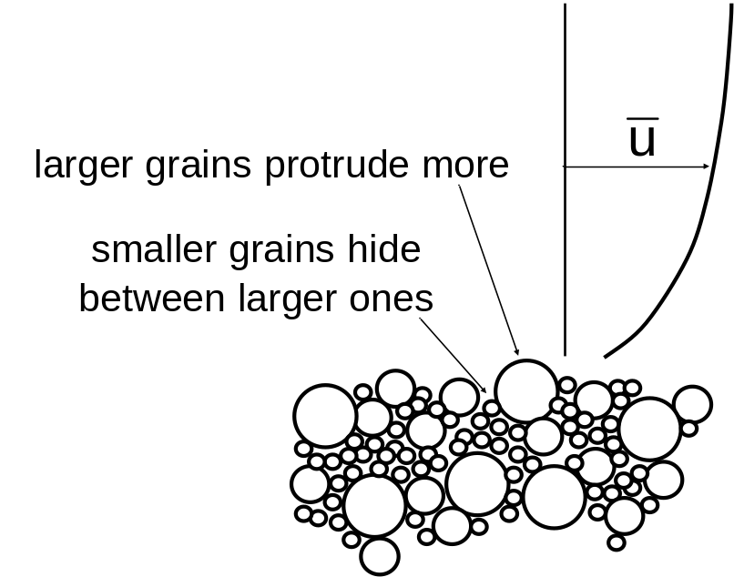
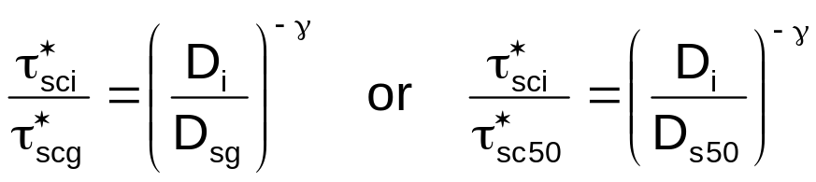
CRITICAL SHIELDS STRESS FOR SEDIMENT MIXTURES
Consider a bed consisting of a mixture of many sizes. The larger grains in the mixture are heavier, and thus harder to move than smaller grains. But the larger grains also protrude out into the flow more, and the smaller grains tend to hide in between them, so rendering larger grains easier to move than smaller grains.
Mass effects make coarser grains harder to move than finer grains. Hiding effects make coarser grains easier to move than finer grains. The net residual is a mild tendency for coarser grains to be harder to move than finer grains, as first shown by Egiazaroff (1965).
Let D_{sg} (D_{s50}) be a surface geometric mean (surface median) size, and let τ_{scg}* (τ_{sc50}*) denote the critical Shields number needed to move that size. The critical Shields number τ_{sci}* need to move size D_{i} on the surface can be related to grain size D_{i} as follows:
where γ varies from about 0.65 to 0.90 (Parker, in press).

Slide 22
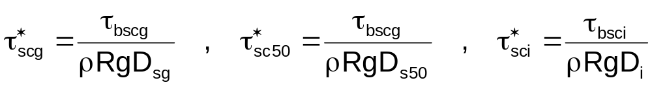

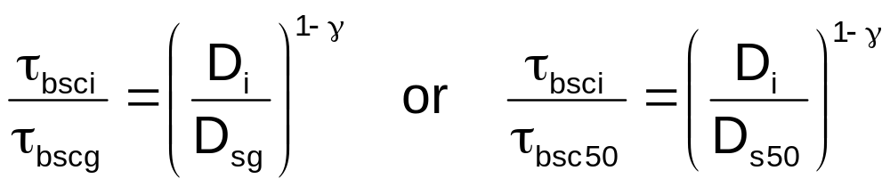
CRITICAL SHIELDS STRESS FOR SEDIMENT MIXTURES contd.
Now let τ_{bscg} (τ_{bsc50}) denote the (dimensioned) critical shear stress needed to move size D_{sg} (D_{s50}), and τ_{bsci} denote the (dimensioned) critical shear stress needed to move size D_{i} in the mixture exposed on the bed surface. By definition, then,
Reducing the above relations with the relations of the previous slide, i.e.
it is found that:

Slide 23

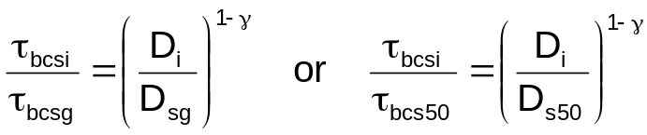

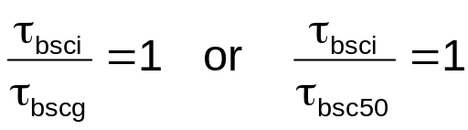
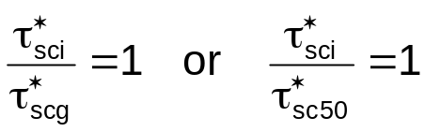
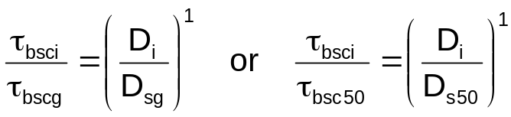
LIMITS OF EQUAL THRESHOLD AND GRAIN INDEPENDENCE
Consider the relations
or
If γ = 1 then all surface grains move at the same absolute value of the boundary shear stress (equal threshold):
or
If γ = 0 then all surface grains move independently of each other, as if they did not feel the effects of their neighbors (grain independence):
or
In most gravel-bed rivers coarser surface grains are harder to move than finer
surface grains, but only mildly so (γ is closer to 1 than 0, but still < 1).

Slide 24
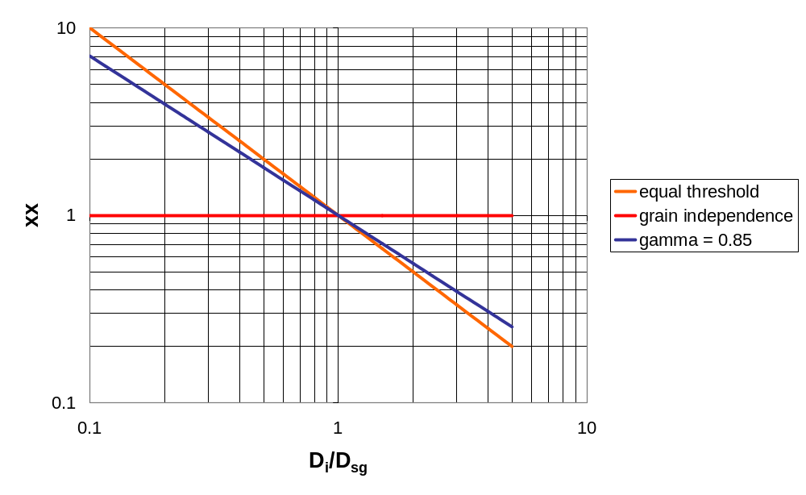
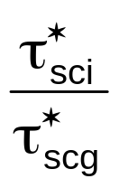
CRITICAL SHIELDS NUMBER FOR SEDIMENT MIXTURES

Slide 25
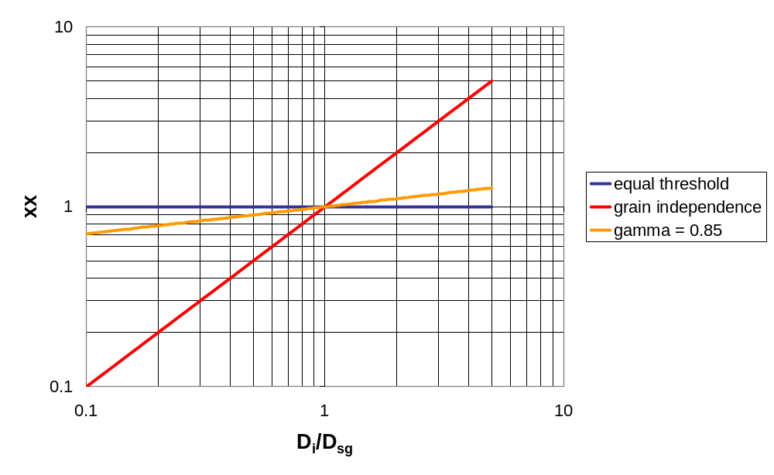
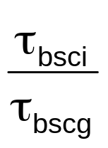
CRITICAL BOUNDARY SHEAR STRESS FOR SEDIMENT MIXTURES

Slide 26
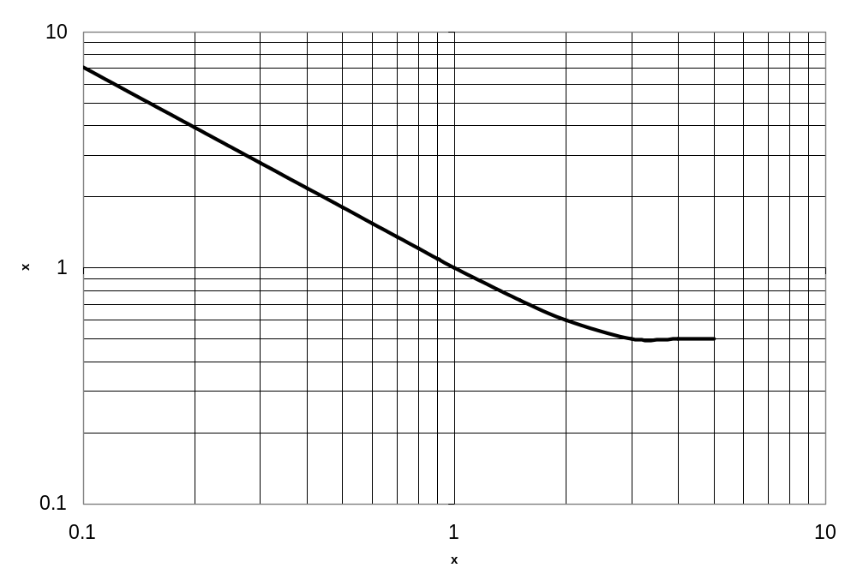

A SIMPLE POWER LAW MAY NOT BE SUFFICIENT
Several researchers (e.g. Proffitt and Sutherland, 1983) have found that a simple power law is not sufficient to represent the relation for the critical Shields stress for mixtures. More specifically, it is found that the curve flattens out as D_{i}/D_{sg} becomes large. That is, the very coarsest grains in a mixture approach the condition of grain independence, with a critical Shields number near 0.015 ~ 0.02 (e.g. Ramette and Heuzel, 1962). The bedload transport relation of Wilcock and Crowe (2003), presented in Chapter 7, captures the essence of this trend; large amounts of sand render gravel easier to move.

Slide 27



CONDITION FOR “SIGNIFICANT” SUSPENSION OF SEDIMENT
In order for sediment to be maintained in suspension to any significant degree, some measure of the characteristic velocity of the turbulent fluctuations of the flow must be at least of the same order of magnitude as the fall velocity v_{s} of the sediment itself. Let u_{rms} denote a characteristic near-bed velocity of the turbulence (“rms” stands for “root-mean-squared”), defined as
where u’, v’ and w’ denote turbulent velocity fluctuations in the streamwise, transverse and upward normal directions and z = b denotes a near-bed elevation such that b/H << 1, where H denotes depth. A loose criterion for the onset of significant turbulence is then
In the case of a rough turbulent flow, the shear velocity near the bed can be evaluated as
(e.g. Tennekes and Lumley, 1972; Nezu and Nakagawa, 1993).

Slide 28




CONDITION FOR “SIGNIFICANT” SUSPENSION OF SEDIMENT contd.
Since turbulence tends to be well-correlated (Tennekes and Lumley, 1972), the following order-of magnitude estimate holds;
from which it can be concluded that
Based on these arguments, Bagnold (1966) proposed the following approximate criterion for the critical shear velocity u_{*sus} for the onset of significant suspension (see also van Rijn, 1984);
Dividing both sides by (RgD)^{1/2}, the following criterion is obtained for the onset of significant suspension:
R_{f} = R_{f}(Re_{p}) defines the functional relationship for fall velocity given in Chapter 2

Slide 29



SHIELDS DIAGRAM WITH CRITERION FOR SIGNIFICANT SUSPENSION

Slide 30


A NOTE ON THE MEANING OF THE “THRESHOLD OF MOTION”
There is no such thing as a precise “threshold of motion” for a granular bed subjected to the flow of a turbulent fluid. Both grain placement and the turbulence of the flow have elements of randomness. For example, Paintal (1971) conducted experiments lasting weeks, and found extremely low rates of sediment transport at values of the Shields number that are below all reasonable estimates of the “critical” Shields number. In particular, he found that at low Shields numbers
where
denotes a dimensionless bedload transport rate (Einstein number, discussed in more detail in the next chapter) and q_{b} denotes the volume bedload transport rate per unit width. Strictly speaking, then, the concept of a threshold of motion is invalid. It is nevertheless a very useful concept for the following reason. If the sediment transport rate is so low that an order-one deviation from the rate would cause negligible morphologic change over a given time span of interest (e.g. 50 years for an engineering problem or 50,000 year for a geological problem),
the flow conditions can be effectively treated as below the threshold of motion.

Slide 31

LOG-LOG PLOT OF PAINTAL BEDLOAD TRANSPORT RELATION
No critical Shields number is evident!

Slide 32

LINEAR-LINEAR PLOT OF PAINTAL BEDLOAD TRANSPORT RELATION
For practical purposes τ_{c}* might be set near 0.023.

Slide 33
REFERENCES FOR CHAPTER 6
Bagnold, R. A., 1966, An approach to the sediment transport problem from general physics, US Geol. Survey Prof. Paper 422-I, Washington, D.C.
Brownlie, W. R., 1981, Prediction of flow depth and sediment discharge in open channels, Report No. KH-R-43A, W. M. Keck Laboratory of Hydraulics and Water Resources, California Institute of Technology, Pasadena, California, USA, 232 p.
Egiazaroff, I. V., 1965, Calculation of nonuniform sediment concentrations, Journal of Hydraulic Engineering, 91(4), 225-247.
Einstein, H. A., 1950, The Bed-load Function for Sediment Transportation in Open Channel Flows, Technical Bulletin 1026, U.S. Dept. of the Army, Soil Conservation Service.
Ikeda, S., 1982, Incipient motion of sand particles on side slopes, Journal of Hydraulic Engineering, 108(1), 95-114.
Neill, C. R., 1968, A reexamination of the beginning of movement for coarse granular bed materials, Report INT 68, Hydraulics Research Station, Wallingford, England.
Nezu, I. and Nakagawa, H., 1993, Turbulence in Open-Channel Flows, Balkema, Rotterdam, 281 p.
Paintal, A. S., 1971, Concept of critical shear stress in loose boundary open channels, Journal of Hydraulic Research, 9(1), 91-113.
Parker, G., Toro-Escobar, C. M., Ramey, M. and S. Beck, 2003, The effect of floodwater extraction on the morphology of mountain streams, Journal of Hydraulic Engineering, 129(11), 885-895.

Slide 34
REFERENCES FOR CHAPTER 6 contd.
Parker, G., in press, Transport of gravel and sediment mixtures, ASCE Manual 54, Sediment Enginering, ASCE, Chapter 3, downloadable from http://cee.uiuc.edu/people/parkerg/manual_54.htm .
Proffitt, G. T. and A. J. Sutherland, 1983, Transport of non-uniform sediments, Journal of Hydraulic Research, 21(1), 33-43.
Ramette, M. and Heuzel, M, 1962, A study of pebble movements in the Rhone by means of tracers, La Houille Blanche, Spécial A, 389-398 (in French).
van Rijn, L., 1984, Sediment transport, Part II: Suspended load transport, Journal of Hydraulic Engineering, 110(11), 1613-1641.
Schlichting, H., 1968, Boundary-Layer Theory, 6th edition. McGraw-Hill, New York, 748 p.
Seminara, G., Solari, L. and Parker, G., 2002, Bedload at low Shields stress on arbitrarily sloping beds: failure of the Bagnold hypothesis, Water Resources Research, 38(11), 1249, doi:10.1029/2001WR000681.
Shields, I. A., 1936, Anwendung der ahnlichkeitmechanik und der turbulenzforschung auf die gescheibebewegung, Mitt. Preuss Ver.-Anst., 26, Berlin, Germany.
Tennekes, H., and Lumley, J. L., 1972, A First Course in Turbulence, MIT Press, Cambridge, USA, 300 p.
Wiberg, P. L. and Smith, J. D., 1987, Calculations of the critical shear stress for motion of uniform and heterogeneous sediments, Water Resources Research, 23(8), 1471-1480.
Wilcock, P. R., and Crowe, J. C., 2003, Surface-based transport model for mixed-size sediment, Journal of Hydraulic Engineering, 129(2), 120-128.

